Slide 1
WireGuard
A Fast, Modern and Secure VPN Tunnel
Developer: Jason A. Donenfeld
Documentation: https://www.wireguard.com/
Objective: Demonstration of the usage of wireguard with network namespaces
Aditya Chirania
181CO104

Slide 2
Contents of the Demonstration
Basic concepts of Wireguard
Installation and preparation for demonstration
Creating a direct node-to-node secure VPN Tunnel.
Creating a relaying/bouncing VPN server.
Using Network Namespaces as an alternative to classical routing table hacks.
Creating a setup to access internet via VPN.
Note : All the above cases will be mere simulations with network namespaces to help viewers attempt the same parallely with ease. It is also important to mention that the point 5 is not a simulation but an alternative used in real world VPN setups.

Slide 3
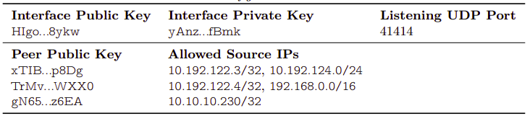
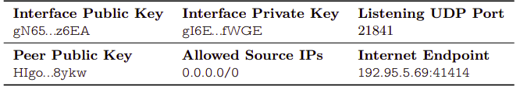
Basic Concepts of Wireguard (Cryptokey Routing, endpoints, roaming)
Node 1, VPN IP: 10.10.10.231/24, Public IP: 192.95.5.69
Node 2, VPN IP: 10.10.10.230/24, Public IP: 192.95.5.64
ping 10.10.10.231
Cryptokey Table Image Credits: www.wireguard.com/papers/wireguard.pdf

Slide 4
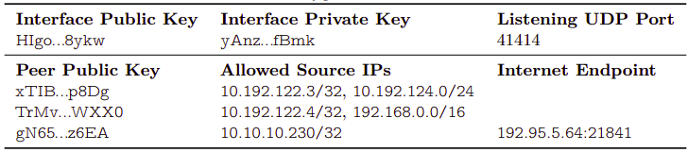
Basic Concepts of Wireguard (Cryptokey Routing, Endpoints, & Roaming)
Node 1, VPN IP: 10.10.10.231/24, Public IP: 192.95.5.69
Node 2, VPN IP: 10.10.10.230/24, Public IP: 192.95.5.64
ping reply
Cryptokey Table Image Credits: www.wireguard.com/papers/wireguard.pdf

Slide 5
Installation and preparation for demonstration
Ubuntu Installation
$ sudo apt install wireguard
For any other linux distributions please refer: www.wireguard.com/install/
To follow parallely along with this demo, please clone this repository by:
$ git clone https://github.com/adityachirania/Wireguard-Demonstration.git

Slide 6
Creating a direct node to node VPN tunnel with wireguard
Initial Setup
Node1
Node2
eth0: 192.168.1.1/24
eth1: 192.168.1.2/24
Steps to create setup (Run as sudo user)
$ cd wireguard-demo/Experiment1
$ bash setup1.sh

Slide 7
Creating a direct node to node VPN tunnel with wireguard
Add wireguard interfaces
Node1
Node2
eth0: 192.168.1.1/24
eth1: 192.168.1.2/24
$ ip netns exec Node1 bash
$ wg genkey > private_node1
$ ip netns exec Node2 bash
$ wg genkey > private_node2

Slide 8
Creating a direct node to node VPN tunnel with wireguard
Add wireguard interfaces
Node1
Node2
wg0
wg0
eth0: 192.168.1.1/24
eth1: 192.168.1.2/24
$ ip netns exec Node1 bash
$ wg genkey > private_node1
$ ip link add wg0 type wireguard
$ ip netns exec Node2 bash
$ wg genkey > private_node2
$ ip link add wg0 type wireguard

Slide 9
Creating a direct node to node VPN tunnel with wireguard
Add wireguard interfaces
Node1
Node2
wg0: 10.0.0.1/24
wg0: 10.0.0.2/24
eth0: 192.168.1.1/24
eth1: 192.168.1.2/24
$ ip netns exec Node1 bash
$ wg genkey > private_node1
$ ip link add wg0 type wireguard
$ ip address add 10.0.0.1/24 dev wg0
$ wg set wg0 private-key ./private_node1
$ ip netns exec Node2 bash
$ wg genkey > private_node2
$ ip link add wg0 type wireguard
$ ip address add 10.0.0.2/24 dev wg0
$ wg set wg0 private-key ./private_node2

Slide 10
Creating a direct node to node VPN tunnel with wireguard
Add wireguard interfaces
Node1
Node2
wg0: 10.0.0.1/24
wg0: 10.0.0.2/24
eth0: 192.168.1.1/24
eth1: 192.168.1.2/24
$ ip link set wg0 up
$ wg
[Interface]
public: xyZ...pq=
private: (hidden)
listening port: 41231
$ wg set wg0 peer yPq...ab= allowed-ips 10.0.0.2/32 endpoint 192.168.1.2:21356
$ ping 10.0.0.2
Endpoint is not mandatory to specify on both ends.
Note the output of “wg” before and after you ping in both namespaces
$ ip link set wg0 up
$ wg
[Interface]
public: yPq...ab=
private: (hidden)
port: 21356
$ wg set wg0 peer xyZ...pq= allowed-ips 10.0.0.1/32

Slide 11
Creating a relaying/bouncing VPN server.
Initial Setup
VPN bouncing server (Node2)
wg0: 10.0.0.2/24
VPN Client (Node1)
VPN Client (Node3)
wg0: 10.0.0.1/24
wg0: 10.0.0.3/24
eth1: 192.168.1.2/24
eth2: 172.16.0.1/24
eth0: 192.168.1.1/24
eth3: 172.16.0.2/24
Steps to create setup (Run as sudo user)
$ cd wireguard-demo/Experiment2
$ bash setup2.sh
This setup has the wireguard interfaces already up and assigned their addresses because we covered how to do so in the previous demo. We shall be focusing on viewing the hops of the packet in this demo.

Slide 12
Creating a relaying/bouncing VPN server
Peers of clients
Node 1’s peers
Node 3
[peers]
1:public-key: <public-key-Node2>
allowed-ips: 10.0.0.0/24
endpoint: 192.168.1.2 : <port-node2>
[peers]
1:public-key: <public-key-Node2>
allowed-ips: 10.0.0.0/24
endpoint: 172.16.0.1 : <port-node2>
Configuration of the VPN Server (Node 2)
[peers]
1:public-key: <public-key-Node1>
allowed-ips: 10.0.0.1/32
endpoint: 192.168.1.1 : <port-node1>
2:public-key: <public-key-Node3>
allowed-ips: 10.0.0.3/32
endpoint: 172.16.0.2 : <port-node3>

Slide 13
Creating a relaying/bouncing VPN server
Finally just run “ping 10.0.0.3” in Node1 and notice that the ping works.
Also Notice the hops across the relay server by running “traceroute -4 10.0.0.3” on Node1 to see the intermediate hop on the relay server.
A relay server can be used to provide continuous access to the VPN network without failure.

Slide 14
Creating a relaying/bouncing VPN server
What happened in the entire process ? Ping 10.0.0.3 from Node 1
UDP Packet created at wg0
10.0.0.1
10.0.0.3
PING MESSAGE

Slide 15
Creating a relaying/bouncing VPN server
What happened in the entire process ? Ping 10.0.0.3 from Node 1
UDP Packet encrypted
XXXXXXXXXXXXXX

Slide 16
Creating a relaying/bouncing VPN server
What happened in the entire process ? Ping 10.0.0.3 from Node 1
Encrypted packet to be sent at endpoint 192.168.1.2: Dst Port from eth0 interface
192.168.1.1 Src Port
192.168.0.1
192.168.1.2 Dst Port.
172.16.0.2
XXXXXXXXXXXXXX
XXXXXXXXXXXXXX

Slide 17
Creating a relaying/bouncing VPN server
What happened in the entire process ? Ping 10.0.0.3 from Node 1
Packet reaches eth1 at Node2 and the data payload is passed on to the wireguard interface listening on port : Port-No.
XXXXXXXXXXXXXX
decrypted
10.0.0.1
10.0.0.3
PING MESSAGE
encrypted
This address’ endpoint is noted (192.168.1.1: Src Port) by wg0
YYYYYYYYYYYYYY

Slide 18
Creating a relaying/bouncing VPN server
What happened in the entire process ? Ping 10.0.0.3 from Node 1
Encrypted packet to be sent at endpoint 172.16.0.2: Dst Port from eth2 interface
172.16.0.1 Src Port
192.168.0.1
172.16.0.2 Dst Port
172.16.0.2
XXXXXXXXXXXXXX
YYYYYYYYYYYYY

Slide 19
Creating a relaying/bouncing VPN server
What happened in the entire process ? Ping 10.0.0.3 from Node 1
Packet reaches eth3 at Node3 and the data payload is passed on to the wireguard interface listening on port : Dst Port.
YYYYYYYYYYYYYY
decrypted
10.0.0.1
10.0.0.3
PING MESSAGE
This address’ endpoint is noted (172.16.0.1: Src Port) by wg0
Now a ping reply is sent back in a similar fashion

Slide 20
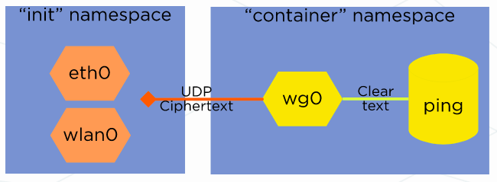
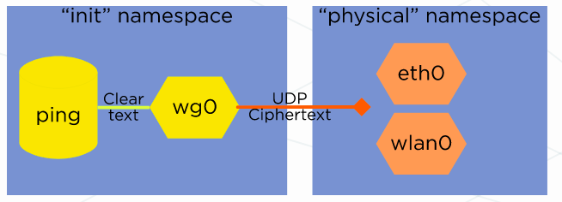
Using network namespaces as an alternative to classical routing table hacks
Useful to give containers a single sole interface
Useful for routing all internet traffic via wireguard
Image credits: www.wireguard.com

Slide 21
Creating a setup to access internet via VPN.
VPN Server (Node2)
VPN Client (Node0 + Node1)
A node on the some other network (Node3)
wg0: 10.0.0.2/24
(Node0)
(Node1)
wg0: 10.0.0.1/24
eth1: 192.168.1.2/24
eth2: 172.16.0.1/24
eth0: 192.168.1.1/24
eth3: 172.16.0.2/24
$ cd wireguard-demo/Experiment3
$ bash setup3.sh

Slide 22
Creating a setup to access internet via VPN.
Enabling the NAT with masquerading at Node2
$ iptables -t nat -A POSTROUTING -s 10.0.0.0/24 -o eth2 -j MASQUERADE
It is necessary to replace the source IP as the gateway to the other network otherwise, it would not be possible to route back to the VPN server. Also a VPN server always replace the sender’s IP with its own IP address to make the VPN client untraceable.

Slide 23
Creating a setup to access internet via VPN.
Now we will run tcpdump on the ethernet interface of the Node3 and we will ping from node0 to IP of Node3 and appreciate the working of the VPN set up.
Node0:
$ ping 172.16.0.2
Node3:
$ tcpdump

Slide 24
Creating a setup to access internet via VPN.
What happened in the entire process ? Ping 172.16.0.2 from Node 0
UDP Packet created at wg0
10.0.0.1
172.16.0.2
PING MESSAGE

Slide 25
Creating a setup to access internet via VPN.
What happened in the entire process ? Ping 172.16.0.2 from Node 0
UDP Packet encrypted
XXXXXXXXXXXXXX

Slide 26
Creating a setup to access internet via VPN.
What happened in the entire process ? Ping 172.16.0.2 from Node 0
Encrypted packet to be sent at endpoint 192.168.1.2: Dst Port from eth0 interface in Node1
192.168.1.1 Src Port
192.168.0.1
192.168.1.2 Dst Port.
172.16.0.2
XXXXXXXXXXXXXX
XXXXXXXXXXXXXX
XXXXXXXXXXXXXX

Slide 27
Creating a setup to access internet via VPN.
What happened in the entire process ? Ping 172.16.0.2 from Node 0
Packet reaches eth1 at Node2 and the data payload is passed on to the wireguard interface listening on port : Port-No.
XXXXXXXXXXXXXX
decrypted
10.0.0.1
172.16.0.2
PING MESSAGE
This address’ endpoint is noted (192.168.1.1: Src Port) by wg0
Now since 172.16.0.2 belongs to the subnet 172.16.0.0/24 it will be sent via interface eth2

Slide 28
Creating a setup to access internet via VPN.
What happened in the entire process ? Ping 172.16.0.2 from Node 0
Now since 172.16.0.2 belongs to the subnet 172.16.0.0/24 it will be sent via interface eth2 to 172.16.0.2 but the NAT will first replace the source IP
10.0.0.1
172.16.0.2
PING MESSAGE
176.16.0.1
172.16.0.2
PING MESSAGE
It then reaches 172.16.0.2 at Node3 and the response is sent back in a similar fashion

Slide 29
Bibliography
https://www.wireguard.com/
https://dev.to/tangramvision/what-they-don-t-tell-you-about-setting-up-a-wireguard-vpn-1h2g
https://github.com/pirate/wireguard-docs

